Slide 1

Web Application Development
COMP-229

Slide 2
Integrating Backend API
Users should be able to use the frontend views to fetch and modify user data in the database based on authentication and authorization.
To implement these functionalities, the React components will access the API endpoints that are exposed by the backend using the Fetch API.
The Fetch API is a newer standard that makes network requests similar to XMLHttpRequest (XHR) but using promises instead, enabling a simpler and cleaner API.
To learn more about the Fetch API,
visit https://developer.mozilla.org/en-US/docs/Web/API/Fetch_API

Slide 3
Fetch for user CRUD
In the client/user/api-user.js file, we will add methods for accessing each of the user CRUD API endpoints, which the React components can use to exchange user data with the server and database as required.
In the following sections, we will look at the implementation of these methods and how they correspond to each CRUD endpoint.

Slide 4
CREATE – creating new user
The create method will take user data from the view component, which is where we will invoke this method. Then, it will use fetch to make a POST call at the create API route, '/api/users', to create a new user in the backend with the provided data.
Finally, in this method, we return the response from the server as a promise. So, the component calling this method can use this promise to handle the response appropriately, depending on what is returned from the server.

Slide 5
LIST – Listing users
Similarly, we will implement the list method next.
The list method will use fetch to make a GET call to retrieve all the users in the database, and then return the response from the server as a promise to the component.
The returned promise, if it resolves successfully, will give the component an array containing the user objects that were retrieved from the database.
In the case of a single user read, we will deal with a single user object instead, as demonstrated next.

Slide 6
Reading a user profile
The read method will use fetch to make a GET call to retrieve a specific user by ID.
Since this is a protected route, besides passing the user ID as a parameter, the requesting component must also provide valid credentials, which, in this case, will be a valid JWT received after a successful sign-in.
mern-skeleton/client/user/api-user.js:

Slide 7
The JWT is attached to the GET fetch call in the Authorization header using the Bearer scheme, and then the response from the server is returned to the component in a promise.
This promise, when it resolves, will either give the component the user details for the specific user or notify that access is restricted to authenticated users.
Similarly, the updated user API method also needs to be passed valid JWT credentials for the fetch call, as shown in the next section.

Slide 8
UPDATE - Updating a user's data
The update method will take changed user data from the view component for a specific user, then use fetch to make a PUT call to update the existing user in the backend.
This is also a protected route that will require a valid JWT as the credential.

Slide 9
As we have seen with the other fetch calls, this method will also return a promise containing the server's response to the user update request.
In the final method, we will learn how to call the user delete API.

Slide 10
Deleting a user
The remove method will allow the view component to delete a specific user from the database and use fetch to make a DELETE call.
This, again, is a protected route that will require a valid JWT as a credential, similar to the read and update methods.
mern-skeleton/client/user/api-user.js:

Slide 11
The response from the server to the delete request will be returned to the component as a promise, as in the other methods.
In these five helper methods, we have covered calls to all the user CRUD-related API endpoints that we implemented on the backend.
Finally, we can export these methods from the api-user.js file as follows.
mern-skeleton/client/user/api-user.js:
export { create, list, read, update, remove }

Slide 12
Updated mern-skeleton/client/user/api-user.js:
const API_BASE = "/api/users";
const handleResponse = async (response) => {
try {
const data = await response.json();
return data;
} catch (err) {
console.error("Failed to parse response JSON:", err);
throw err;
}
};
const handleError = (err) => {
console.error("API call failed:", err);
throw err;
};
const create = async (user) => {
try {
const response = await fetch(API_BASE, {
method: "POST",
headers: {
Accept: "application/json",
"Content-Type": "application/json",
},

Slide 13
Updated mern-skeleton/client/user/api-user.js contd.
body: JSON.stringify(user),
});
return await handleResponse(response);
} catch (err) {
return handleError(err);
}
};
const list = async (signal) => {
try {
const response = await fetch(API_BASE, {
method: "GET",
signal,
});
return await handleResponse(response);
} catch (err) {
return handleError(err);
}
};
const read = async ({ userId }, { t }, signal) => {
try {
const response = await fetch(`${API_BASE}/${userId}`, {
method: "GET",
signal,
headers: {
Accept: "application/json",
"Content-Type": "application/json",
Authorization: `Bearer ${t}`,
},
});
return await handleResponse(response);
} catch (err) {
return handleError(err);
}
};

Slide 14
Updated mern-skeleton/client/user/api-user.js contd.
const update = async ({ userId }, { t }, user) => {
try {
const response = await fetch(`${API_BASE}/${userId}`, {
method: "PUT",
headers: {
Accept: "application/json",
"Content-Type": "application/json",
Authorization: `Bearer ${t}`,
},
body: JSON.stringify(user),
});
return await handleResponse(response);
} catch (err) {
return handleError(err);
}
};
const remove = async ({ userId }, { t }) => {
try {
const response = await fetch(`${API_BASE}/${userId}`, {
method: "DELETE",
headers: {
Accept: "application/json",
"Content-Type": "application/json",
Authorization: `Bearer ${t}`,
},
});
return await handleResponse(response);
} catch (err) {
return handleError(err);
}
};
export { create, list, read, update, remove };

Slide 15
These user CRUD methods can now be imported and used by the React components as required.
Next, we will implement similar helper methods to integrate the auth-related API endpoints.

Slide 16
Fetch for the auth API
In order to integrate the auth API endpoints from the server with the frontend
React components, we will add methods for fetching sign-in and sign-out API
endpoints in the client/lib/api-auth.js file. Let's take a look at them.

Slide 17
Sign-in
The signin method will take user sign-in data from the view component, then use fetch to make a POST call to verify the user with the backend.
mern-skeleton/client/lib/api-auth.js:

Slide 18
The response from the server will be returned to the component in a promise, which may provide the JWT if sign-in was successful.
The component invoking this method needs to handle the response appropriately, such as storing the received JWT locally so it can be used when making calls to other protected API routes from the frontend.
We will look at the implementation for this when we implement the Sign In view later.
After the user is successfully signed in, we also want the option to call the signout API when the user is signing out.
The call to the signout API is discussed next.

Slide 19
Sign-out
We will add a signout method to api-auth.js, which will use fetch to make a GET call to the signout API endpoint on the server.
mern-skeleton/client/lib/api-auth.js:

Slide 20
This method will also return a promise to inform the component about whether the API request was successful.
At the end of the api-auth.js file, we will export the signin and signout methods.
mern-skeleton/client/lib/api-auth.js:
export { signin, signout }

Slide 21
Updated mern-skeleton/client/lib/api-auth.js:
const signin = async (user) => {
try {
let response = await fetch("/auth/signin/", {
method: "POST",
headers: {
Accept: "application/json",
"Content-Type": "application/json",
},
credentials: "include",
body: JSON.stringify(user),
});
return await response.json();
} catch (err) {
console.log(err);
}
};
const signout = async () => {
try {
let response = await fetch("/auth/signout/", { method: "GET" });
return await response.json();
} catch (err) {
console.log(err);
}
};
export { signin, signout };

Slide 22
Now, these methods can be imported into the relevant React components so that we can implement the user sign-in and signout features.
With these API fetch methods added, the React frontend has complete access to the endpoints we made available in the backend.
Before we start putting these methods to use in our React components, we will look into how user auth state can be maintained across the frontend.

Slide 23
Adding auth in the frontend
As we discussed earlier, implementing authentication with JWT relinquishes responsibility to the client-side to manage and store user auth state.
To this end, we need to write code that will allow the client-side to store the JWT that's received from the server on successful sign-in, make it available when accessing protected routes, delete or invalidate the token when the user signs out, and also restrict access to views and components on the frontend based on the user auth state.

Slide 24
Using examples of the auth workflow from the React Router documentation, in the following sections, we will write helper methods to manage the auth state across the components and also use a custom PrivateRoute component to add protected routes to the frontend of the MERN skeleton application.

Slide 25
Managing auth state
To manage auth state in the frontend of the application, the frontend needs to be able to store, retrieve, and delete the auth credentials that are received from the server on successful user sign in.
In our MERN applications, we will use the browser's sessionsStorage as the storage option to store the JWT auth credentials.
Alternatively, you can use localStorage instead of sessionStorage to store the JWT credentials.
With sessionStorage, the user auth state will only be remembered in the current window tab.
With localStorage, the user auth state will be remembered across tabs in a browser.

Slide 26
In client/lib/auth-helper.js, we will define the helper methods discussed in the following sections to store and retrieve JWT credentials from client-side sessionStorage and also clear out the sessionStorage on user sign-out.

Slide 27
Saving credentials
In order to save the JWT credentials that are received from the server on successful sign-in, we use the authenticate method, which is defined as follows.
mern-skeleton/client/lib/auth-helper.js:

Slide 28
The authenticate method takes the JWT credentials, jwt, and a callback function, cb, as arguments.
It stores the credentials in sessionStorage after ensuring window is defined, in other words ensuring this code is running in a browser and hence has access to sessionStorage.
Then, it executes the callback function that is passed in. This callback will allow the component – in our case, the component where sign-in is called – to define actions that should take place after successfully signing in and storing credentials.
Next, we will discuss the method that lets us access these stored credentials.

Slide 29
Retrieving credentials
In our frontend components, we will need to retrieve the stored credentials to check if the current user is signed in.
In the isAuthenticated() method, we can retrieve these credentials from sessionStorage.
mern-skeleton/client/lib/auth-helper.js:

Slide 30
A call to isAuthenticated() will return either the stored credentials or false, depending on whether credentials were found in sessionStorage.
Finding credentials in storage will mean a user is signed in, whereas not finding credentials will mean the user is not signed in. We will also add a method that allows us to delete the credentials from storage when a signed-in user signs out from the application.

Slide 31
Deleting credentials
When a user successfully signs out from the application, we want to clear the stored JWT credentials from sessionStorage.
This can be accomplished by calling the clearJWT method, which is defined in the following code.
mern-skeleton/client/lib/auth-helper.js:

Slide 32
Updated mern-skeleton/client/lib/auth-helper.js:
authenticate(jwt, cb) {
if(typeof window !== "undefined")
sessionStorage.setItem('jwt', JSON.stringify(jwt))
cb()
}
isAuthenticated() {
if (typeof window == "undefined")
return false
if (sessionStorage.getItem('jwt'))
return JSON.parse(sessionStorage.getItem('jwt'))
else
return false
}
clearJWT(cb) {
if(typeof window !== "undefined")
sessionStorage.removeItem('jwt')
cb()
signout().then((data) => {
document.cookie = "t=; expires=Thu, 01 Jan 1970 00:00:00 UTC; path=/;"
})
}

Slide 33
Updated mern-skeleton/client/lib/auth-helper.js:
import { signout } from "./api-auth.js";
const auth = {
isAuthenticated() {
if (typeof window == "undefined") return false;
if (sessionStorage.getItem("jwt"))
return JSON.parse(sessionStorage.getItem("jwt"));
else return false;
},
authenticate(jwt, cb) {
if (typeof window !== "undefined")
sessionStorage.setItem("jwt", JSON.stringify(jwt));
cb();
},
clearJWT(cb) {
if (typeof window !== "undefined") sessionStorage.removeItem("jwt");
cb(); //optional
signout().then((data) => {
document.cookie = "t=; expires=Thu, 01 Jan 1970 00:00:00 UTC; path=/;";
});
},
};
export default auth;

Slide 34
This clearJWT method takes a callback function as an argument, and it removes the JWT credential from sessionStorage.
The passed in cb() function allows the component initiating the signout functionality to dictate what should happen after a successful sign-out.
The clearJWT method also uses the signout method we defined earlier in api-auth.js to call the signout API in the backend.
If we had used cookies to store the credentials instead of sessionStorage, the response to this API call would be where we clear the cookie, as shown in the preceding code.

Slide 35
Using the signout API call is optional since this is dependent on whether cookies are used as the credential storage mechanism.
With these three methods, we now have ways of storing, retrieving, and deleting JWT credentials on the client-side.
Using these methods, the React components we build for the frontend will be able to check and manage user auth state to restrict access in the frontend, as demonstrated in the following section with the custom PrivateRoute component.

Slide 36
The PrivateRoute component
The code in the file defines the PrivateRoute component, as shown in the auth flow example at https://reacttraining.com/react-router/web/example/auth-workflow, which can be found in the React Router documentation.
It will allow us to declare protected routes for the frontend to restrict view access based on user auth.

Slide 37
mern-skeleton/client/lib/PrivateRoute.jsx:
import React from 'react';
import { Route, Navigate, useLocation } from 'react-router-dom';
import auth from './auth-helper';
const PrivateRoute = ({ children, ...rest }) => {
const location = useLocation();
return auth.isAuthenticated() ? (
children
) : (
<Navigate
to="/signin"
state={{ from: location }}
replace
/>
);
};
export default PrivateRoute;

Slide 38
Components to be rendered in this PrivateRoute will only load when the user is authenticated, which is determined by a call to the isAuthenticated method; otherwise, the user will be redirected to the Signin component.
We load the components that should have restricted access, such as the user profile component, in a PrivateRoute.
This will ensure that only authenticated users are able to view the user profile page.
With the backend APIs integrated and the auth management helper methods ready for use in the components, we can now start building the remaining view components that utilize these methods and complete the frontend.

Slide 39
Completing the User frontend
The React components that will be described in this section complete the interactive features we defined for the skeleton by allowing users to view, create, and modify user data stored in the database with respect to auth restrictions.
The components we will implement are as follows:
Users: To fetch and list all users from the database to the view
Signup: To display a form that allows new users to sign up
Signin: To display a form that allows existing users to sign in
Profile: To display details for a specific user after retrieving from the database

Slide 40
EditProfile: To display details for a specific user and allow authorized user to update these details
DeleteUser: To allow an authorized user to delete their account from the application
Menu: To add a common navigation bar to each view in the application.
For each of these components, we will go over their unique aspects, as well as how to add them to the application in the MainRouter.

Slide 41
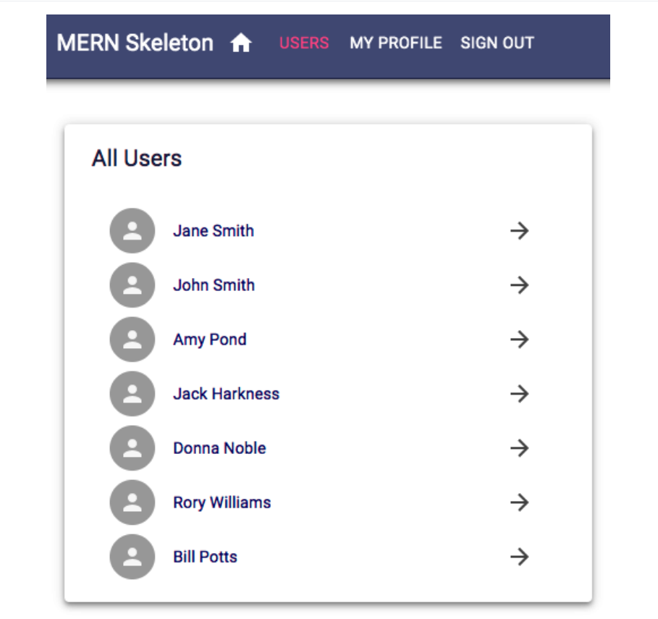
The Users component
The Users component in client/user/Users.jsx shows the names of all the users that have been fetched from the database and links each name to the user profile.
The following component can be viewed by any visitor to the application and will render at the '/users' route:

Slide 42
Updated mern-skeleton/client/user/Users.jsx:
import React, { useState, useEffect } from "react";
import {
Paper,
List,
ListItem,
ListItemAvatar,
ListItemText,
ListItemSecondaryAction,
IconButton,
Avatar,
Typography,
Link,
} from "@mui/material";
import ArrowForward from "@mui/icons-material/ArrowForward";
import { list } from "./api-user.js";
import { Link as RouterLink } from "react-router-dom";
export default function Users() {
const [users, setUsers] = useState([]);
useEffect(() => {
const abortController = new AbortController();
const signal = abortController.signal;

Slide 43
Updated mern-skeleton/client/user/Users.jsx contd.
list(signal).then((data) => {
if (data?.error) {
console.log(data.error);
} else {
setUsers(data);
}
});
return () => abortController.abort();
}, []);
return (
<Paper
elevation={4}
sx={{
maxWidth: 600,
mx: "auto",
mt: 5,
p: 3,
}}
>
<Typography variant="h6" sx={{ mb: 2, color: "text.primary" }}>
All Users
</Typography>
<List dense>
{users.map((item, i) => (
<Link

Slide 44
Updated mern-skeleton/client/user/Users.jsx contd.
component={RouterLink}
to={`/user/${item._id}`}
underline="none"
key={item._id}
sx={{ color: "inherit" }}
>
<ListItem button>
<ListItemAvatar>
<Avatar />
</ListItemAvatar>
<ListItemText primary={item.name} />
<ListItemSecondaryAction>
<IconButton edge="end">
<ArrowForward />
</IconButton>
</ListItemSecondaryAction>
</ListItem>
</Link>
))}
</List>
</Paper>
);
}

Slide 45
Users.jsx code Explanation
• Import React and React hooks: useState to store data and useEffect to run side effects when the component mounts.
• Import Material-UI components for building the UI: Paper, List, ListItem, Avatars, Typography, Icons, and Buttons.
• Import the list function from the API module to fetch user data.
• Import Link from react-router-dom and rename it as RouterLink for navigation links.
• Define a functional component called Users.
• Create a state variable users to store the list of users, initialized as an empty array.
• Use the useEffect hook to fetch data when the component mounts.
• Create an AbortController to allow canceling the API request if the component unmounts early.
• Call the list function, passing the abort signal, and wait for the data.
• If there's an error in the response, log it to the console.
• Otherwise, update the users state with the fetched data.
• Return a cleanup function that aborts the API call when the component unmounts.
• Return the component's UI structure inside the JSX.
• Use a styled Paper component as the container with padding, width, and margin styles.
• Add a Typography component to display the title "All Users".
• Render a Material-UI List component.
• Loop through each user in the users array.
• For each user, create a clickable link using the Link component integrated with RouterLink.
• Set the link’s target path to the user’s profile page using their unique ID.
• Inside each link, add a ListItem that behaves like a button.
• Display a user avatar using the Avatar component.
• Display the user’s name using ListItemText.
• Add a secondary action with an IconButton containing a right-arrow icon to indicate navigation.
• Close the List and Paper components.

Slide 46
To add this Users component to the React application, we need to update the MainRouter component with a Route that renders this component at the '/users' path.
mern-skeleton/client/MainRouter.jsx:
<Route path="/users" element={<Users/>}/>

Slide 47
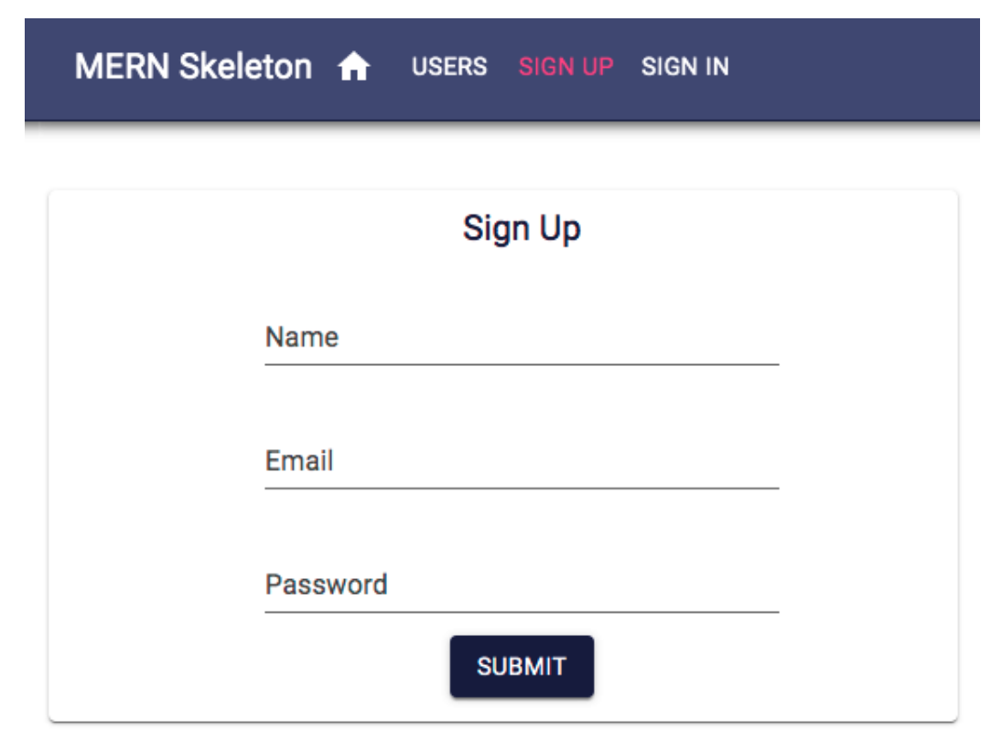
The Signup component
The Signup component in client/user/Signup.jsx presents a form with name, email, and password fields to the user for sign-up at the '/signup' path, as displayed in the following screenshot:

Slide 48
Updated mern-skeleton/client/user/Signup.jsx:
import React, { useState } from "react";
import {
Card,
CardContent,
Typography,
TextField,
CardActions,
Button,
Dialog,
DialogTitle,
DialogContent,
DialogContentText,
DialogActions,
} from "@mui/material";
import { Link } from "react-router-dom";
import { create } from "./api-user";
export default function Signup() {
const [values, setValues] = useState({
name: "",
password: "",
email: "",
error: "",
});

Slide 49
Updated mern-skeleton/client/user/Signup.jsx contd.
const [open, setOpen] = useState(false);
const handleChange = (name) => (event) => {
setValues({ ...values, [name]: event.target.value });
};
const handleClose = () => {
setOpen(false);
};
const clickSubmit = () => {
const user = {
name: values.name || undefined,
email: values.email || undefined,
password: values.password || undefined,
};
create(user).then((data) => {
if (data.error) {
setValues({ ...values, error: data.error });
} else {
setOpen(true);
}
});
};

Slide 50
Updated mern-skeleton/client/user/Signup.jsx contd.
return (
<div>
<Card
sx={{
maxWidth: 400,
margin: "0 auto",
mt: 3,
p: 2,
textAlign: "center",
}}
>
<CardContent>
<Typography variant="h6" sx={{ fontSize: 18 }}>
Sign Up
</Typography>
<TextField
id="name"
label="Name"
sx={{ width: "100%", mb: 2 }}
value={values.name}
onChange={handleChange("name")}
margin="normal"
/>

Slide 51
Updated mern-skeleton/client/user/Signup.jsx contd.
<TextField
id="email"
label="Email"
sx={{ width: "100%", mb: 2 }}
value={values.email}
onChange={handleChange("email")}
margin="normal"
/>
<TextField
id="password"
label="Password"
sx={{ width: "100%", mb: 2 }}
value={values.password}
onChange={handleChange("password")}
type="password"
margin="normal"
/>
{values.error && (
<Typography color="error" sx={{ mt: 1 }}>
{values.error}
</Typography>
)}

Slide 52
Updated mern-skeleton/client/user/Signup.jsx contd.
</CardContent>
<CardActions>
<Button
color="primary"
variant="contained"
onClick={clickSubmit}
sx={{ margin: "0 auto", mb: 2 }}
>
Submit
</Button>
</CardActions>
</Card>
<Dialog open={open} onClose={handleClose}>
<DialogTitle>New Account</DialogTitle>
<DialogContent>
<DialogContentText>
New account successfully created.
</DialogContentText>
</DialogContent>
<DialogActions>
<Link to="/signin">
<Button

Slide 53
Updated mern-skeleton/client/user/Signup.jsx contd.
color="primary"
autoFocus
variant="contained"
onClick={handleClose}
>
Sign In
</Button>
</Link>
</DialogActions>
</Dialog>
</div>
);
}

Slide 54
Signup.jsx code explanation
• Import React and useState hook to manage component state.
• Import Material-UI components for building the form and dialog UI.
• Import Link from react-router-dom to navigate to the sign-in page.
• Import the create function from the API module to handle the signup request.
• Define a functional component called Signup.
• Initialize the state values to store form inputs: name, email, password, and error message.
• Initialize another state open to control whether the success dialog is displayed.
• Define the handleChange function to update the relevant field in the values state whenever the user types in an input field.
• Define the handleClose function to close the success dialog by setting open to false.
• Define the clickSubmit function that runs when the user clicks the submit button.
• Create a user object containing the name, email, and password from the form inputs, using undefined as fallback values if any field is empty.
• Call the create API function with the user object and handle the response.
• If the response contains an error, update the state to display the error message.
• If the signup is successful, open the success dialog by setting open to true.
• Return the JSX structure of the component.
• Render a Card as the main container for the signup form, centered with some padding.
• Inside the Card, display the title "Sign Up" using Typography.
• Render a TextField for the user's name, linked to the values.name state and updated by the handleChange function.
• Render a TextField for the user's email, also linked to state and updated on change.
• Render a TextField for the user's password, set to type="password" to hide the text.
• If there's an error stored in the state, display it using a Typography component styled in red.
• Add a Button inside CardActions that triggers the clickSubmit function when clicked.
• Render a Dialog that appears when the open state is true, showing a confirmation message for successful signup.
• The dialog has a title indicating a new account was created.
• Inside the dialog content, show a brief success message.
• In the dialog actions, add a button wrapped in a Link that navigates the user to the sign-in page.
• Clicking the "Sign In" button also closes the dialog.
• End of the component.

Slide 55
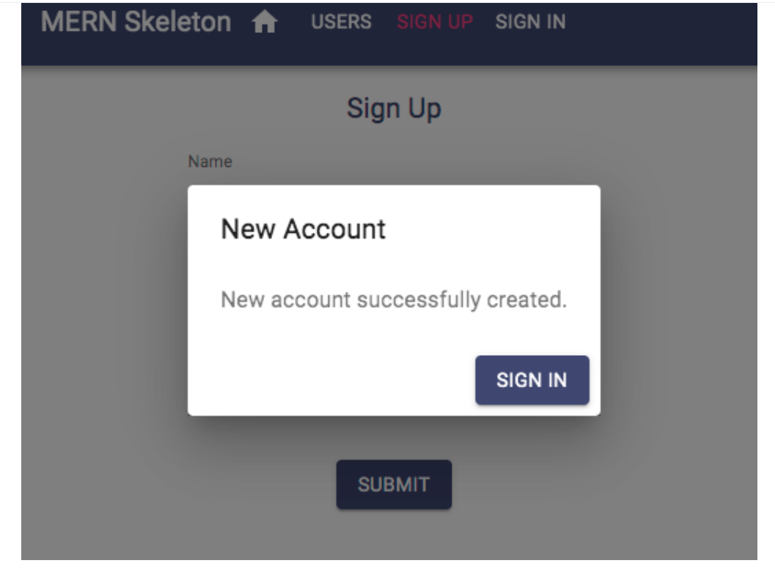
On successful account creation, the user is given confirmation and asked to sign in using this Dialog component, which links to the Signin component, as shown in the following screenshot:

Slide 56
To add the Signup component to the app, add the following Route to MainRouter.

Slide 57
mern-skeleton/client/MainRouter.jsx:
<Route path="/signup" element={<Signup/>}/>

Slide 58
Updated mern-skeleton/client/MainRouter.jsx:
import React from 'react'
import {Route, Routes} from 'react-router-dom'
import Home from './core/Home'
import Users from './user/Users.jsx'
import Signup from './user/Signup.jsx'
const MainRouter = () => {
return ( <div>
<Routes>
<Route exact path="/" element={<Home />} />
<Route path="/users" element={<Users />} />
<Route path="/signup" element={<Signup />}/>
</Routes>
</div>
)
}
export default MainRouter

Slide 59
This will render the Signup view at '/signup'. Similarly, we will implement the Signin component next.

Slide 60
The Signin component
The Signin component in client/lib/Signin.jsx is also a form with only email and password fields for signing in.
This component is quite similar to the Signup component and will render at the '/signin' path.
The key difference is in the implementation of redirection after a successful sign-in and storing the received JWT credentials.
The rendered Signin component can be seen in the following screenshot:

Slide 61
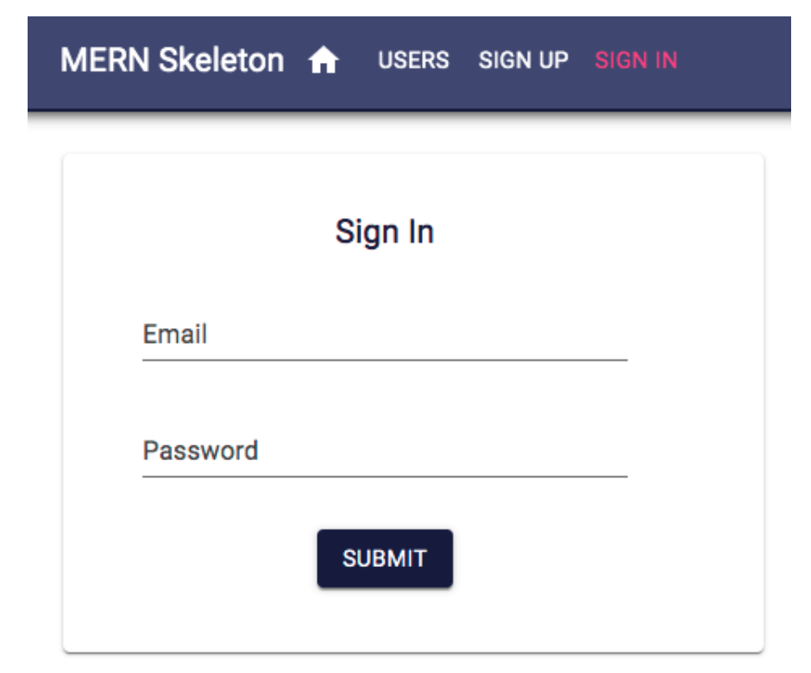

Slide 62
Updated mern-skeleton/client/lib/Signin.jsx:
import React, { useState } from "react";
import Card from "@mui/material/Card";
import CardActions from "@mui/material/CardActions";
import CardContent from "@mui/material/CardContent";
import Button from "@mui/material/Button";
import TextField from "@mui/material/TextField";
import Typography from "@mui/material/Typography";
import Icon from "@mui/material/Icon";
import auth from "./auth-helper.js";
import { Navigate, useLocation } from "react-router-dom";
import { signin } from "./api-auth.js";
export default function Signin() {
const location = useLocation();
const [values, setValues] = useState({
email: "",
password: "",
error: "",
redirectToReferrer: false,
});

Slide 63
Updated mern-skeleton/client/lib/Signin.jsx contd
const clickSubmit = () => {
const user = {
email: values.email || undefined,
password: values.password || undefined,
};
signin(user).then((data) => {
if (data.error) {
setValues({ ...values, error: data.error });
} else {
auth.authenticate(data, () => {
setValues({ ...values, error: "", redirectToReferrer: true });
});
}
});
};
const handleChange = (name) => (event) => {
setValues({ ...values, [name]: event.target.value });
};
const { from } = location.state || {
from: { pathname: "/" },
};

Slide 64
Updated mern-skeleton/client/lib/Signin.jsx contd.
const { redirectToReferrer } = values;
if (redirectToReferrer) {
return <Navigate to={from} />;
}
return (
<Card
sx={{
maxWidth: 600,
margin: "auto",
textAlign: "center",
mt: 5,
pb: 2,
}}
>
<CardContent>
<Typography variant="h6" sx={{ mt: 2, color: "text.primary" }}>
Sign In
</Typography>
<TextField
id="email"
type="email"
label="Email"
sx={{ mx: 1, width: 300 }}

Slide 65
Updated mern-skeleton/client/lib/Signin.jsx contd.
value={values.email}
onChange={handleChange("email")}
margin="normal"
/>
<br />
<TextField
id="password"
type="password"
label="Password"
sx={{ mx: 1, width: 300 }}
value={values.password}
onChange={handleChange("password")}
margin="normal"
/>
<br />
{values.error && (
<Typography component="p" color="error" sx={{ mt: 1 }}>
<Icon color="error" sx={{ verticalAlign: "middle", mr: 0.5 }}>
error
</Icon>
{values.error}
</Typography>
)}

Slide 66
Updated mern-skeleton/client/lib/Signin.jsx contd.
</CardContent>
<CardActions>
<Button
color="primary"
variant="contained"
onClick={clickSubmit}
sx={{ margin: "auto", mb: 2 }}
>
Submit
</Button>
</CardActions>
</Card>
);
}

Slide 67
Signin.jsx code Explanation
• Import React and useState hook to manage form state.
• Import Material-UI components (Card, Button, TextField, etc.) to build the sign-in form UI.
• Import an icon component for displaying error messages visually.
• Import the auth helper module for handling authentication (saving tokens, etc.).
• Import React Router's Navigate and useLocation for handling redirects after sign-in.
• Import the signin function from the API module to handle the sign-in request.
• Define the Signin functional component.
• Use the useLocation hook to access the current route location, which may include redirection info.
• Initialize the values state with fields for email, password, error messages, and redirect flag.
• Define the clickSubmit function to run when the user clicks the submit button.
• Create a user object from the entered email and password (or undefined if missing).
• Call the signin API function, passing the user object.
• If the response has an error, update the state to display the error message.
• If sign-in is successful, call auth.authenticate to save the user's credentials.
• After authentication, update the state to clear errors and trigger a redirect.
• Define the handleChange function to update the appropriate form field in the state when the user types.
• Extract the from path from the location state or default to the home page ("/").
• Extract the redirectToReferrer value from the state.
• If redirectToReferrer is true, return a Navigate component to redirect the user to the desired page.
• Return the JSX structure of the sign-in form.
• Render a centered Card as the main container.
• Inside the card, display the title "Sign In" using a styled Typography component.
• Render a TextField for the email, linked to the state, and update it on change.
• Render another TextField for the password, also linked to the state.
• If there's an error message in the state, display it using a Typography component along with an error icon.
• Below the inputs, render a Submit button.
• Clicking the button triggers the clickSubmit function to attempt sign-in.
• End of the component.

Slide 68
To add the Signin component to the app, add the following Route to MainRouter.
mern-skeleton/client/MainRouter.jsx:
<Route path="/signin" element={<Signin />}/>

Slide 69
Updated mern-skeleton/client/MainRouter.jsx:
import React from 'react'
import {Route, Routes} from 'react-router-dom'
import Home from './core/Home'
import Users from './user/Users.jsx'
import Signup from './user/Signup.jsx'
import Signin from ‘./lib/Signin.jsx'
const MainRouter = () => {
return ( <div>
<Routes>
<Route exact path="/" element={<Home />} />
<Route path="/users" element={<Users />} />
<Route path="/signup" element={<Signup />} />
<Route path="/signin" element={<Signin />}/>
</Routes>
</div>
)
}
export default MainRouter

Slide 70
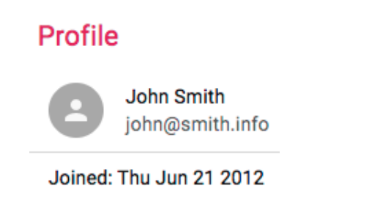
The Profile component
The Profile component in client/user/Profile.jsx shows a single user's information in the view at the '/user/:userId' path, where the userId parameter represents the ID of the specific user.
The completed Profile will display user details, and also conditionally show edit/delete options.
The following screenshot shows how the Profile renders when the user currently browsing is viewing someone else's profile and not their own profile:

Slide 71
This profile information can be fetched from the server if the user is signed in.
To verify this, the component has to provide the JWT credential to the read fetch call; otherwise, the user should be redirected to the Sign In view.
In the Profile component definition, we need to initialize the state with an empty user and set redirectToSignin to false.

Slide 72
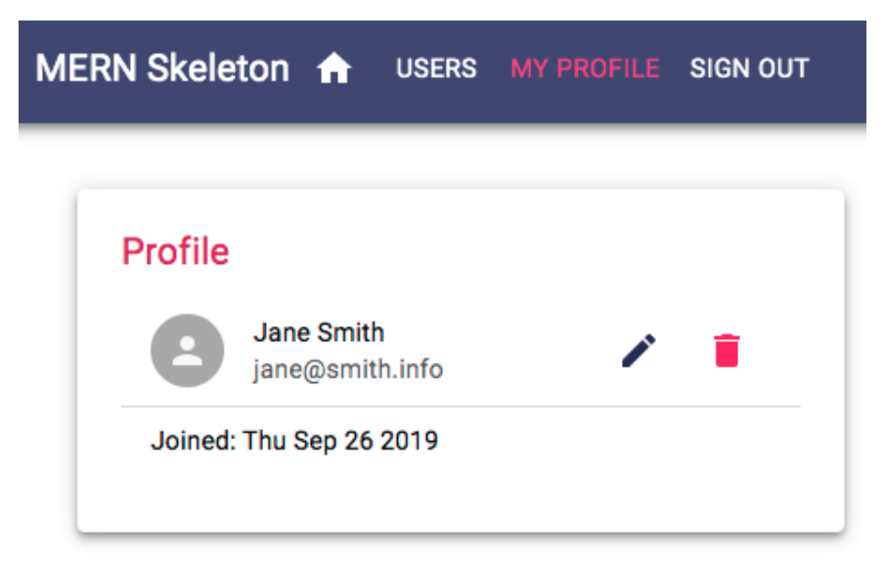
However, if the user that's currently signed in is viewing their own profile, they will be able to see edit and delete options in the Profile component, as shown in the following screen shot:

Slide 73
Updated mern-skeleton/client/user/Profile.jsx:
import React, { useState, useEffect } from "react";
import {
Paper,
List,
ListItem,
ListItemAvatar,
ListItemSecondaryAction,
ListItemText,
Avatar,
IconButton,
Typography,
Divider,
} from "@mui/material";
import EditIcon from "@mui/icons-material/Edit";
import PersonIcon from "@mui/icons-material/Person";
import DeleteUser from "./DeleteUser";
import auth from "../lib/auth-helper.js";
import { read } from "./api-user.js";
import { useLocation, Navigate, Link, useParams } from "react-router-dom";

Slide 74
Updated mern-skeleton/client/user/Profile.jsx contd.
export default function Profile() {
const location = useLocation();
const [user, setUser] = useState({});
const [redirectToSignin, setRedirectToSignin] = useState(false);
const jwt = auth.isAuthenticated();
const { userId } = useParams();
useEffect(() => {
const abortController = new AbortController();
const signal = abortController.signal;
read({ userId }, { t: jwt.token }, signal).then((data) => {
if (data && data.error) {
setRedirectToSignin(true);
} else {
setUser(data);
}
});
return () => abortController.abort();
}, [userId]);

Slide 75
Updated mern-skeleton/client/user/Profile.jsx contd.
if (redirectToSignin) {
return (
<Navigate to="/signin" state={{ from: location.pathname }} replace />
);
}
return (
<Paper
elevation={4}
sx={{
maxWidth: 600,
mx: "auto",
mt: 5,
p: 3,
}}
>
<Typography variant="h6" sx={{ mt: 3, mb: 2, color: "text.primary" }}>
Profile
</Typography>
<List dense>
<ListItem>
<ListItemAvatar>
<Avatar>
<PersonIcon />

Slide 76
Updated mern-skeleton/client/user/Profile.jsx contd.
</Avatar>
</ListItemAvatar>
<ListItemText primary={user.name} secondary={user.email} />
{auth.isAuthenticated().user &&
auth.isAuthenticated().user._id === user._id && (
<ListItemSecondaryAction>
<Link to={`/user/edit/${user._id}`}>
<IconButton aria-label="Edit" color="primary">
<EditIcon />
</IconButton>
</Link>
<DeleteUser userId={user._id} />
</ListItemSecondaryAction>
)}
</ListItem>
<Divider />
<ListItem>
<ListItemText
primary={
user.created
? `Joined: ${new Date(user.created).toDateString()}`
: "Loading..."
}
/>

Slide 77
Updated mern-skeleton/client/user/Profile.jsx contd.
</ListItem>
</List>
</Paper>
);
}

Slide 78
Profile.jsx code Explanation
Import React and the hooks useState and useEffect to manage state and side effects.
Import Material-UI components for building the UI, such as Paper, List, Typography, Avatar, and icons.
Import EditIcon and PersonIcon from MUI icons for visual elements.
Import the DeleteUser component for user deletion functionality.
Import the auth helper to access authentication details.
Import the read function from the API to fetch user data.
Import routing utilities: useLocation, Navigate, Link, and useParams from react-router-dom.
Define the Profile functional component.
Use useLocation to get the current page’s location for potential redirection.
Initialize user state to store the user's profile data.
Initialize redirectToSignin state to control redirection if the user is not authenticated.
Retrieve the authenticated user's token and info using auth.isAuthenticated().
Extract the userId from the route parameters using useParams.
Use useEffect to fetch user data when the component mounts or when userId changes.
Create an AbortController to allow aborting the fetch request if needed.
Call the read function with the user ID and authentication token to fetch the profile data.
If the response contains an error (e.g., unauthorized), set redirectToSignin to true to trigger a redirect.
Otherwise, update the user state with the fetched profile data.
Return a cleanup function to abort the fetch if the component unmounts.
If redirectToSignin is true, return a Navigate component to redirect the user to the sign-in page.
Otherwise, render the profile UI inside a styled Paper component.
Add a Typography heading that says "Profile".
Render a List to hold the profile details.
In the first ListItem, display the user's avatar using a PersonIcon inside an Avatar.
Display the user's name and email using ListItemText.
Check if the authenticated user is the same as the profile user.
If so, render two actions:
A link to the edit profile page with an edit icon.
The DeleteUser component allowing the user to delete their own account.
Add a visual divider.
In the next ListItem, display the date the user joined, or show "Loading..." if the data is not yet available.
End of the component.

Slide 79
The Edit button will route to the EditProfile component, while the custom DeleteUser component will handle the delete operation with the userId passed to it as a prop.
To add the Profile component to the app, add the Route to MainRouter.

Slide 80
mern-skeleton/client/MainRouter.jsx:
<Route path="/user/:userId" element={<Profile />}/>

Slide 81
Updated mern-skeleton/client/MainRouter.jsx:
import React from 'react'
import {Route, Routes} from 'react-router-dom'
import Home from './core/Home'
import Users from './user/Users.jsx'
import Signup from './user/Signup.jsx'
import Signin from './lib/Signin.jsx'
import Profile from './user/Profile.jsx'
const MainRouter = () => {
return ( <div>
<Routes>
<Route exact path="/" element={<Home />} />
<Route path="/users" element={<Users />} />
<Route path="/signup" element={<Signup/>} />
<Route path="/signin" element={<Signin/>} />
<Route path="/user/:userId" element={<Profile/>}/>
</Routes>
</div>
)
}
export default MainRouter

Slide 82
To visit this route in the browser and render a Profile with user details, the link should be composed with a valid user ID in it. In the next section, we will use this same approach of retrieving single user details and rendering it in the component to implement the Edit Profile view.

Slide 83
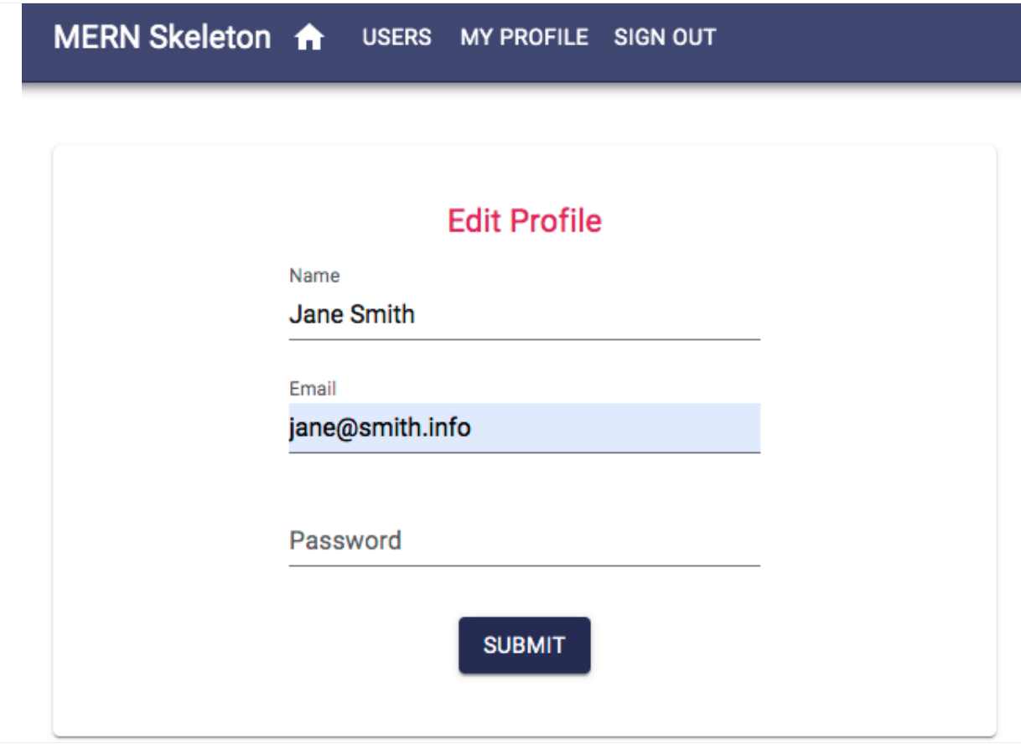
The EditProfile component
The EditProfile component in client/user/EditProfile.jsx has similarities in its implementation to both the Signup and Profile components.
It allows the authorized user to edit their own profile information in a form similar to the signup form, as shown in the following screenshot:

Slide 84
Upon loading at '/user/edit/:userId', the component will fetch the user's information with their ID after verifying JWT for auth and then load the form with the received user information.
The form will allow the user to edit and submit only the changed information to the update fetch call, and, on successful update, redirect the user to the Profile view with updated information.
EditProfile will load the user information the same way as in the Profile component, that is, by fetching with read in useEffect using the userId parameter from match.params.
It will gather credentials from auth.isAuthenticated.

Slide 85
The form view will contain the same elements as the Signup component, with the input values being updated in the state when they change.
On form submit, the component will call the update fetch method with the userId, JWT and updated user data.

Slide 86
Updated mern-skeleton/client/user/EditProfile.jsx:
import React, { useState, useEffect } from "react";
import {
Card,
CardActions,
CardContent,
Button,
TextField,
Typography,
Icon,
} from "@mui/material";
import auth from "../lib/auth-helper.js";
import { read, update } from "./api-user.js";
import { Navigate, useParams } from "react-router-dom";
export default function EditProfile() {
const { userId } = useParams();
const [values, setValues] = useState({
name: "",
password: "",
email: "",
open: false,
error: "",
NavigateToProfile: false,
});

Slide 87
Updated mern-skeleton/client/user/EditProfile.jsx contd.
const jwt = auth.isAuthenticated();
useEffect(() => {
const abortController = new AbortController();
const signal = abortController.signal;
read({ userId }, { t: jwt.token }, signal).then((data) => {
if (data?.error) {
setValues((prev) => ({ ...prev, error: data.error }));
} else {
setValues((prev) => ({ ...prev, name: data.name, email: data.email }));
}
});
return () => abortController.abort();
}, [userId]);
const clickSubmit = () => {
const user = {
name: values.name || undefined,
email: values.email || undefined,
password: values.password || undefined,
};

Slide 88
Updated mern-skeleton/client/user/EditProfile.jsx contd.
update({ userId }, { t: jwt.token }, user).then((data) => {
if (data?.error) {
setValues((prev) => ({ ...prev, error: data.error }));
} else {
setValues((prev) => ({
...prev,
userId: data._id,
NavigateToProfile: true,
}));
}
});
};
const handleChange = (name) => (event) => {
setValues({ ...values, [name]: event.target.value });
};
if (values.NavigateToProfile) {
return <Navigate to={`/user/${values.userId}`} />;
}

Slide 89
Updated mern-skeleton/client/user/EditProfile.jsx contd.
return (
<Card
sx={{
maxWidth: 600,
mx: "auto",
mt: 5,
textAlign: "center",
pb: 2,
}}
>
<CardContent>
<Typography variant="h6" sx={{ mt: 2, mb: 2, color: "text.primary" }}>
Edit Profile
</Typography>
<TextField
id="name"
label="Name"
value={values.name}
onChange={handleChange("name")}
margin="normal"
sx={{ mx: 1, width: 300 }}
/>
<br />

Slide 90
Updated mern-skeleton/client/user/EditProfile.jsx contd.
<TextField
id="email"
type="email"
label="Email"
value={values.email}
onChange={handleChange("email")}
margin="normal"
sx={{ mx: 1, width: 300 }}
/>
<br />
<TextField
id="password"
type="password"
label="Password"
value={values.password}
onChange={handleChange("password")}
margin="normal"
sx={{ mx: 1, width: 300 }}
/>
<br />

Slide 91
Updated mern-skeleton/client/user/EditProfile.jsx contd.
{values.error && (
<Typography component="p" color="error" sx={{ mt: 1 }}>
<Icon color="error" sx={{ verticalAlign: "middle", mr: 1 }}>
error
</Icon>
{values.error}
</Typography>
)}
</CardContent>
<CardActions sx={{ justifyContent: "center" }}>
<Button
color="primary"
variant="contained"
onClick={clickSubmit}
sx={{ mb: 2 }}
>
Submit
</Button>
</CardActions>
</Card>
);
}

Slide 92
EditProfile.jsx code Explanation
• Import React along with useState and useEffect for managing state and side effects.
• Import Material-UI components such as Card, Button, TextField, Typography, and Icon to build the form UI.
• Import the auth helper to access the authenticated user's credentials.
• Import the read and update API functions for fetching and updating user data.
• Import React Router's Navigate and useParams for navigation and accessing URL parameters.
• Define the EditProfile functional component.
• Extract the userId from the route parameters using useParams.
• Initialize state values to store form data: name, email, password, error message, a flag for success (NavigateToProfile), and modal state (open).
• Retrieve the authentication token and user info by calling auth.isAuthenticated().
• Use the useEffect hook to fetch the current user’s data when the component mounts or when userId changes.
• Create an AbortController to cancel the request if the component unmounts before completion.
• Call the read function with the user ID and token to fetch the user's existing details.
• If the API response contains an error, update the state to show the error message.
• If successful, update the state with the fetched user's name and email.
• Return a cleanup function to abort the API call if necessary.
• Define the clickSubmit function, triggered when the user clicks the submit button.
• Prepare the updated user object using the current state values.
• Call the update API function with the user ID, token, and updated user data.
• If the response contains an error, update the state to show the error.
• If the update is successful, update the state to set NavigateToProfile to true and store the user ID.
• Define the handleChange function to update the respective form field in the state whenever the user types.
• If NavigateToProfile is true, redirect the user to the profile page of the updated user using the Navigate component.
• Otherwise, render the UI:
• Display the main form inside a centered Card component with padding.
• Add a title "Edit Profile" using Typography.
• Render a TextField for the user's name, linked to state, updating on change.
• Render a TextField for the user's email, linked to state, updating on change.
• Render a TextField for the user's password, linked to state, updating on change.
• If there’s an error in the state, display it using a styled Typography with an error icon.
• Add a submit Button that triggers the clickSubmit function.
• End of the component.

Slide 93
To add the EditProfile component to the app, we will use a PrivateRoute, which will restrict the component from loading at all if the user is not signed in.
The order of placement in MainRouter will also be important.

Slide 94
mern-skeleton/client/MainRouter.jsx:
<Route
path="/user/edit/:userId"
element={
<PrivateRoute>
<EditProfile />
</PrivateRoute>
}
/>
<Route path="/user/:userId" element={<Profile />}/>

Slide 95
Updated mern-skeleton/client/MainRouter.jsx:
import React from 'react'
import {Route, Routes} from 'react-router-dom'
import Home from './core/Home'
import Users from './user/Users.jsx'
import Signup from './user/Signup.jsx'
import Signin from ‘./lib/Signin.jsx'
import Profile from './user/Profile.jsx’
//import Switch from 'react'
import PrivateRoute from './lib/PrivateRoute.jsx'
import EditProfile from './user/EditProfile.jsx'
const MainRouter = () => {
return ( <div>
<Routes>
<Route exact path="/" element={<Home />} />
<Route path="/users" element={<Users />} />
<Route path="/signup" element={<Signup/>} />
<Route path="/signin" element={<Signin/>} />
<PrivateRoute path="/user/edit/:userId" element={EditProfile}/>
<Route path="/user/:userId" element={<Profile />}/>
</Routes>
</div>
)
}
export default MainRouter

Slide 96
The route with the '/user/edit/:userId' path needs to be placed before the route with the '/user/:userId' path, so that the edit path is matched first exclusively when this route is requested and not confused with the Profile route.
With this profile edit view added, we only have the user delete UI implementation left to complete the user-related frontend.

Slide 97
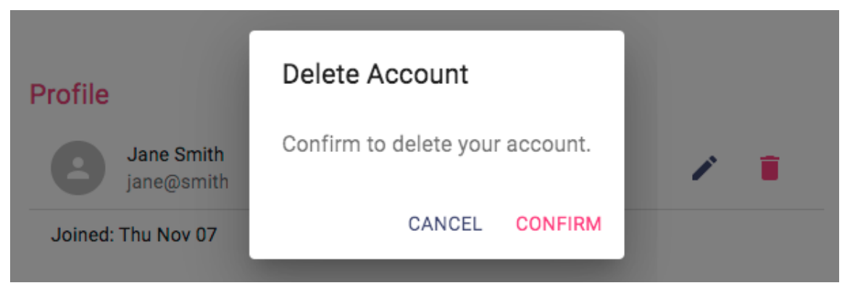
The DeleteUser component
The DeleteUser component in client/user/DeleteUser.jsx is basically a button that we will add to the Profile view that, when clicked, opens a Dialog component asking the user to confirm the delete action, as shown in the following screenshot:

Slide 98
This component initializes the state with open set to false for the Dialog component, as well as redirect set to false so that it isn't rendered first.

Slide 99
Updated mern-skeleton/client/user/DeleteUser.jsx:
import React, { useState } from "react";
import PropTypes from "prop-types";
import IconButton from "@mui/material/IconButton";
import Button from "@mui/material/Button";
import DeleteIcon from "@mui/icons-material/Delete";
import Dialog from "@mui/material/Dialog";
import DialogActions from "@mui/material/DialogActions";
import DialogContent from "@mui/material/DialogContent";
import DialogContentText from "@mui/material/DialogContentText";
import DialogTitle from "@mui/material/DialogTitle";
import auth from "../lib/auth-helper.js";
import { remove } from "./api-user.js";
import { Navigate } from "react-router-dom";
export default function DeleteUser({ userId }) {
const [open, setOpen] = useState(false);
const [redirect, setRedirect] = useState(false);
const jwt = auth.isAuthenticated();
const clickButton = () => {
setOpen(true);
};

Slide 100
Updated mern-skeleton/client/user/DeleteUser.jsx contd.
const deleteAccount = () => {
remove({ userId }, { t: jwt.token }).then((data) => {
if (data?.error) {
console.error(data.error);
} else {
auth.clearJWT(() => console.log("deleted"));
setRedirect(true);
}
});
};
const handleRequestClose = () => {
setOpen(false);
};
if (redirect) {
return <Navigate to="/" />;
}
return (
<>

Slide 101
Updated mern-skeleton/client/user/DeleteUser.jsx contd.
<IconButton
aria-label="Delete account"
onClick={clickButton}
color="error"
>
<DeleteIcon />
</IconButton>
<Dialog open={open} onClose={handleRequestClose}>
<DialogTitle>Delete Account</DialogTitle>
<DialogContent>
<DialogContentText>
Are you sure you want to delete your account? This action is
irreversible.
</DialogContentText>
</DialogContent>
<DialogActions>
<Button onClick={handleRequestClose} color="primary">
Cancel
</Button>
<Button
onClick={deleteAccount}
color="error"

Slide 102
Updated mern-skeleton/client/user/DeleteUser.jsx contd.
variant="contained"
autoFocus
>
Confirm
</Button>
</DialogActions>
</Dialog>
</>
);
}
DeleteUser.propTypes = {
userId: PropTypes.string.isRequired,
};

Slide 103
DeleteUser.jsx code Explanation
• Import React along with useState and useEffect for managing state and side effects.
• Import Material-UI components such as Card, Button, TextField, Typography, and Icon to build the form UI.
• Import the auth helper to access the authenticated user's credentials.
• Import the read and update API functions for fetching and updating user data.
• Import React Router's Navigate and useParams for navigation and accessing URL parameters.
• Define the EditProfile functional component.
• Extract the userId from the route parameters using useParams.
• Initialize state values to store form data: name, email, password, error message, a flag for success (NavigateToProfile), and modal state (open).
• Retrieve the authentication token and user info by calling auth.isAuthenticated().
• Use the useEffect hook to fetch the current user’s data when the component mounts or when userId changes.
• Create an AbortController to cancel the request if the component unmounts before completion.
• Call the read function with the user ID and token to fetch the user's existing details.
• If the API response contains an error, update the state to show the error message.
• If successful, update the state with the fetched user's name and email.
• Return a cleanup function to abort the API call if necessary.
• Define the clickSubmit function, triggered when the user clicks the submit button.
• Prepare the updated user object using the current state values.
• Call the update API function with the user ID, token, and updated user data.
• If the response contains an error, update the state to show the error.
• If the update is successful, update the state to set NavigateToProfile to true and store the user ID.
• Define the handleChange function to update the respective form field in the state whenever the user types.
• If NavigateToProfile is true, redirect the user to the profile page of the updated user using the Navigate component.
• Otherwise, render the UI:
• Display the main form inside a centered Card component with padding.
• Add a title "Edit Profile" using Typography.
• Render a TextField for the user's name, linked to state, updating on change.
• Render a TextField for the user's email, linked to state, updating on change.
• Render a TextField for the user's password, linked to state, updating on change.
• If there’s an error in the state, display it using a styled Typography with an error icon.
• Add a submit Button that triggers the clickSubmit function.
• End of the component.

Slide 104
Since we are using the DeleteUser component in the Profile component, it gets added to the application view when Profile is added in MainRouter.
With the delete user UI added, we now have a frontend that contains all the React component views in order to complete the skeleton application features.
But we still need a common navigation UI to link all these views together and make each view easy to access for the frontend user.
In the next section, we will implement this navigation menu component.

Slide 105
The Menu component
The Menu component will function as a navigation bar across the frontend application by providing links to all the available views, and also by indicating the user's current location in the application.

Slide 106
Updated mern-skeleton/client/core/Menu.jsx:
import React from "react";
import AppBar from "@mui/material/AppBar";
import Toolbar from "@mui/material/Toolbar";
import Typography from "@mui/material/Typography";
import IconButton from "@mui/material/IconButton";
import HomeIcon from "@mui/icons-material/Home";
import Button from "@mui/material/Button";
import auth from "../lib/auth-helper";
import { Link, useNavigate, useLocation } from "react-router-dom";
const isActive = (location, path) =>
location.pathname === path ? "#ff4081" : "#ffffff";
export default function Menu() {
const navigate = useNavigate();
const location = useLocation();
return (
<AppBar position="static">
<Toolbar sx={{ display: "flex", gap: 2, alignItems: "center" }}>
<Typography variant="h6" sx={{ flexGrow: 1 }}>
MERN Skeleton
</Typography>

Slide 107
Updated mern-skeleton/client/core/Menu.jsx contd.
<Link to="/">
<IconButton aria-label="Home" sx={{ color: isActive(location, "/") }}>
<HomeIcon />
</IconButton>
</Link>
<Link to="/users">
<Button sx={{ color: isActive(location, "/users") }}>Users</Button>
</Link>
{!auth.isAuthenticated() && (
<>
<Link to="/signup">
<Button sx={{ color: isActive(location, "/signup") }}>
Sign up
</Button>
</Link>
<Link to="/signin">
<Button sx={{ color: isActive(location, "/signin") }}>
Sign In
</Button>
</Link>
</>
)}

Slide 108
Updated mern-skeleton/client/core/Menu.jsx contd.
{auth.isAuthenticated() && (
<>
<Link to={`/user/${auth.isAuthenticated().user._id}`}>
<Button
sx={{
color: isActive(
location,
`/user/${auth.isAuthenticated().user._id}`
),
}}
>
My Profile
</Button>
</Link>
<Button
sx={{ color: "#ffffff" }}
onClick={() => {
auth.clearJWT(() => navigate("/"));
}}
>
Sign out
</Button>
</>
)}
</Toolbar>
</AppBar>
);
}

Slide 109
To indicate the current location of the application on the Menu, we will highlight the link that matches the current location path by changing the color conditionally.

Slide 110
mern-skeleton/client/core/Menu.jsx:
const isActive = (history, path) => {
if (history.location.pathname == path)
return {color: '#ff4081'}
else
return {color: '#ffffff'}
}

Slide 111
The isActive function is used to apply color to the buttons in the Menu, as follows:
style={isActive(history, "/users")} – This line of script already exist in the Menu.jsx

Slide 112

The remaining links such as SIGN IN, SIGN UP, MY PROFILE, and SIGN OUT will show up on the Menu based on whether the user is signed in or not.
The following screenshot shows how the Menu renders when the user is not signed in:
For example, the links to SIGN UP and SIGN IN should only appear on the menu when the user is not signed in.
Therefore, we need to add it to the Menu component after the Users button with a condition.

Slide 113
mern-skeleton/client/core/Menu.jsx:
{
!auth.isAuthenticated() && (<span>
<Link to="/signup">
<Button style={isActive(history, "/signup")}> Sign Up </Button>
</Link>
<Link to="/signin">
<Button style={isActive(history, "/signin")}> Sign In </Button>
</Link>
</span>)
}

Slide 114
Similarly, the link to MY PROFILE and the SIGN OUT button should only appear on the menu when the user is signed in, and should be added to the Menu component with the following condition check.

Slide 115
mern-skeleton/client/core/Menu.jsx:
{
auth.isAuthenticated() && (<span>
<Link to={"/user/" + auth.isAuthenticated().user._id}>
<Button style={isActive(location, "/user/" + auth.isAuthenticated().user._id)}>My Profile</Button>
</Link>
<Button color="inherit" onClick={() => {
auth.clearJWT(() => navigate('/'));
}}>Sign out</Button>
</span>)
}

Slide 116
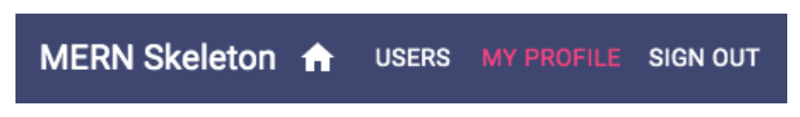
The MY PROFILE button uses the signed-in user's information to link to the user's own profile, while the SIGN OUT button calls the auth.clearJWT() method when it's clicked.
When the user is signed in, the Menu will look as follows:
To have the Menu navigation bar present in all the views, we need to add it to the MainRouter before all the other routes, and outside the Switch component.

Slide 117
mern-skeleton/client/MainRouter.jsx:
<Menu/>

Slide 118
Updated mern-skeleton/client/MainRouter.jsx:
import React from 'react';
import { Routes, Route } from 'react-router-dom';
//import React from 'react'
//import {Route, Routes} from 'react-router-dom'
import Home from './core/Home'
import Users from './user/Users.jsx'
import Signup from './user/Signup.jsx'
import Signin from './auth/Signin.jsx'
import Profile from './user/Profile.jsx'
import Switch from 'react'
import PrivateRoute from './lib/PrivateRoute.jsx'
import EditProfile from './user/EditProfile.jsx'
import Menu from './core/Menu'
function MainRouter() {
return (
<div>
<Menu/>
<Routes>
<Route path="/" element={<Home />} />
<Route path="/users" element={<Users />} />
<Route path="/signup" element={<Signup />} />
<Route path="/signin" element={<Signin />} />
<Route
path="/user/edit/:userId"
element={
<PrivateRoute>
<EditProfile />
</PrivateRoute>
}
/>
<Route path="/user/:userId" element={<Profile />} />
</Routes>
</div>
);
}
export default MainRouter;

Slide 119
This will make the Menu component render on top of all the other components when these components are accessed at their respective routes.
The skeleton frontend is now complete and has all necessary components to allow a user to sign up, view, and modify user data on the backend while considering authentication and authorization restrictions.
However, it is still not possible to visit the frontend routes directly in the browser address bar; these can only be accessed when they're linked from within the frontend view.
To enable this functionality in the skeleton application, we need to implement basic server-side rendering.

Slide 120
CONNECTING THE FRONTEND AND BACKEND
To connect the frontend and Backend since the backend(server) is running on port 3000, add the following code to the vite.config.js file as follows:

Slide 121
Vite.config.js
import { defineConfig } from "vite";
import react from "@vitejs/plugin-react";
const { PORT = 3000} = process.env;
export default defineConfig({
plugins: [react()],
server:{
proxy:{
'/api':{
target:`http://localhost:${PORT}`,
changeOrigin: true,
},
'/auth': {
target:`http://localhost:${PORT}`,
changeOrigin: true,
},
},
},
build: {
manifest: true,
rollupOptions: {
input: "./src/main.jsx",
},
},
});

Slide 122
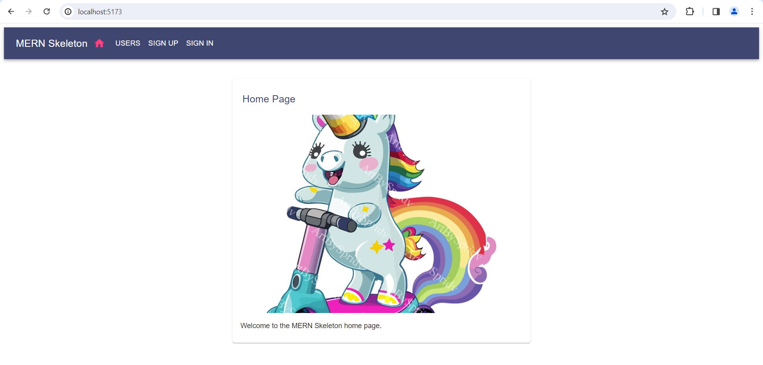

Slide 123
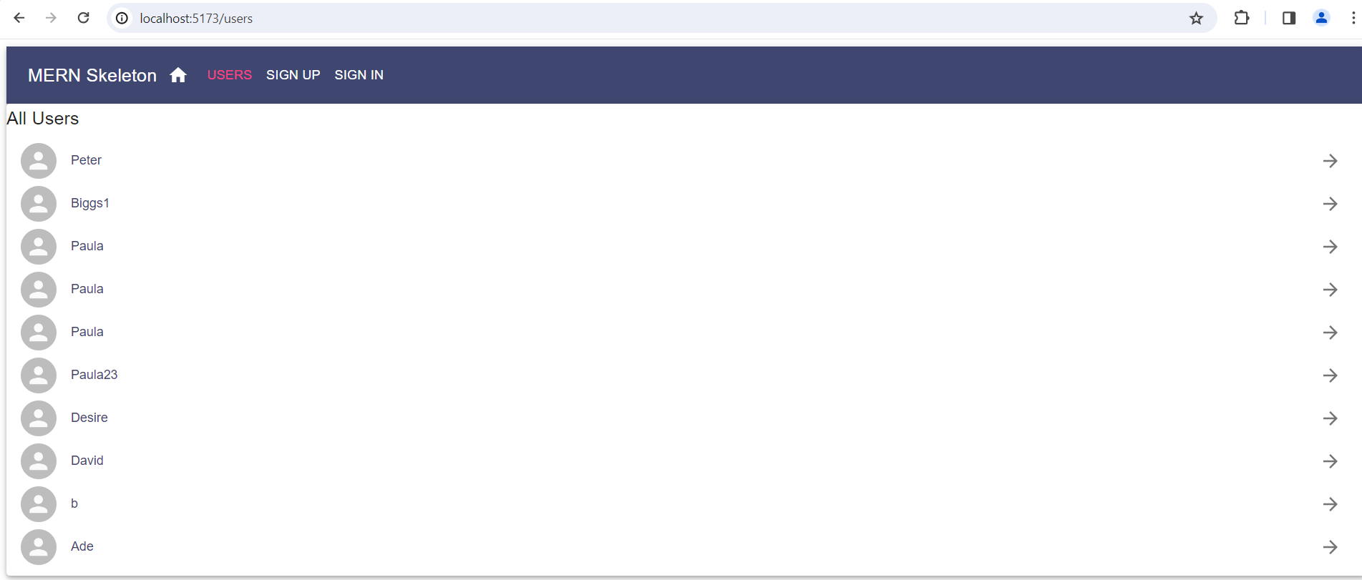

Slide 124
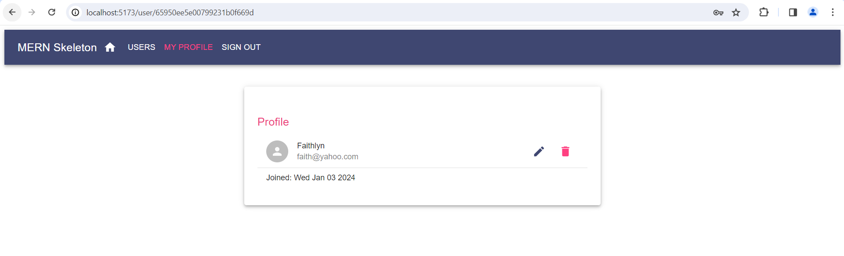
When you click on a signed in user the screen below is displayed, so you can edit or delete the profile.

Slide 125
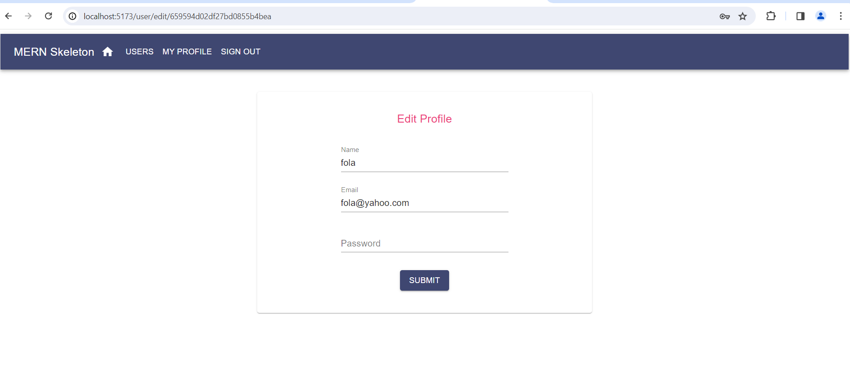
Edit Profile – Only signed in users can edit their profile.

Slide 126
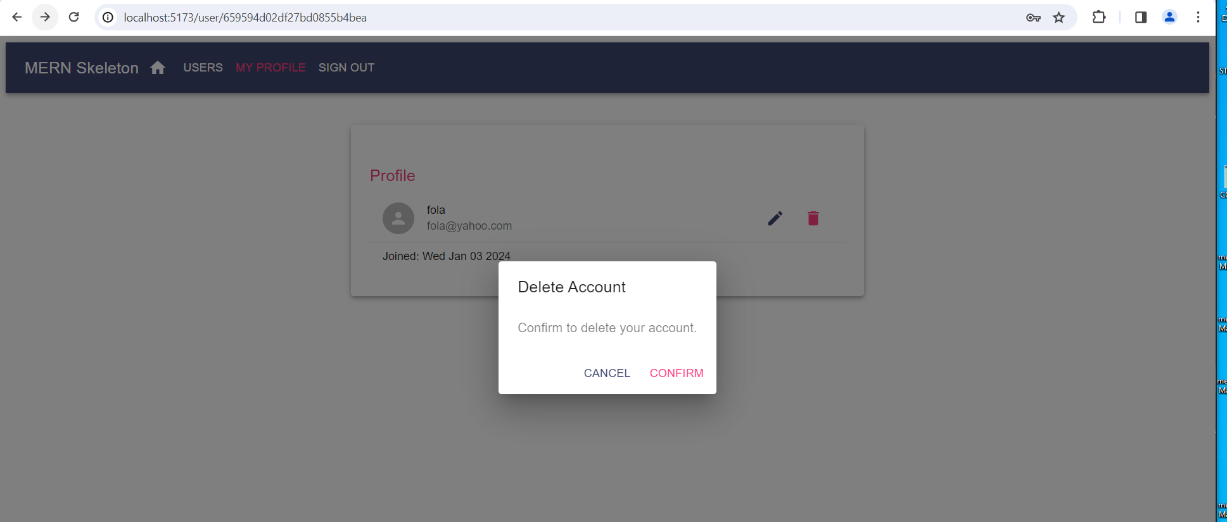
Delete Profile

